Slide 1
Audenshaw School
Year 9 – GCSE Guided Pathways (Options)

Slide 2
Core Subjects
These subjects are compulsory for all students.
English Language and Literature (2 GCSEs)
Mathematics (1 GCSE)
Science Combined (2 GCSEs) or Triple (3 GCSEs)
RE (Short course) For all students

Slide 3
EBacc – English Baccalaureate
This is a group of subject that keeps students’ options open for further study and careers.
The EBacc includes English, Mathematics, History, Geography, French, Spanish, and the Sciences.
To follow the EBacc, students will need to pick French or Spanish and History or Geography as two of their options.
The EBacc is not a separate qualification.

Slide 4
Science – Combined or Triple?
All students study Science for GCSE.
Students have the option to chose Triple Science if they are in Sets 1 and 2 and have shown engagement in lessons during Year 9.
Students should select Triple Science if they are interested in science or want to take a science A-Level.
If students choose Triple Science, they will get separate GCSEs in Biology, Chemistry & Physics.

Slide 5
Studying a Language – French or Spanish.
Curriculum change has enabled students to focus on one language in Year 9, doubling their experience of the language and culture.
Graduates with a language on average earn more money than those without.
Learning a language shows that you have good creative skills and you can see different ways to solve problems.
It helps you understand a lot more about the world and other cultures.
The opportunity for international careers and travel. Many UK citizens work across Europe because they are able to speak another language.

Slide 6
Other GCSE Subjects:
These subjects lead to full GCSE qualifications:
Art & Design
Business Studies
Computing
Design & Technology – Food
Design & Technology - Systems
Design & Technology – 3D Design
Music
Photography
Religious Studies

Slide 7
Vocational courses:
Students should pick these courses if they are interested in these areas for future careers or courses:
ICT
Sport
Engineering
A maximum of 3 vocational courses can be studied.

Slide 8
Picking your subjects
All students will be studying English, mathematics and science.
Students pick one subject (and a reserve) from Block A.

Slide 9
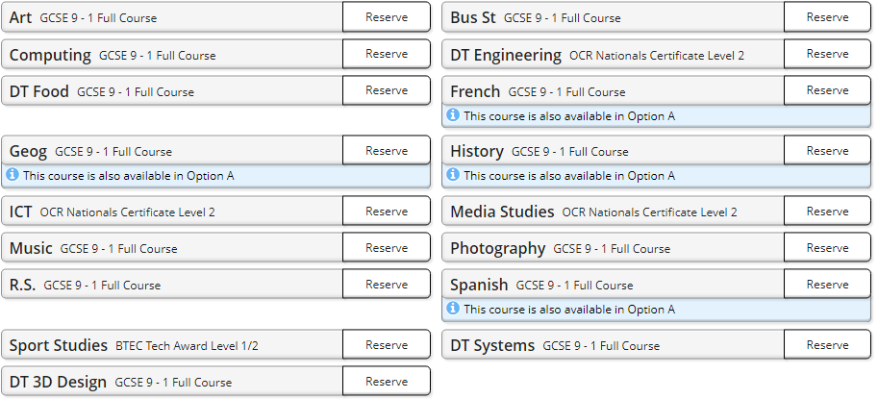
Picking your subjects
All students pick three subjects (and two reserves) from Block B.

Slide 10
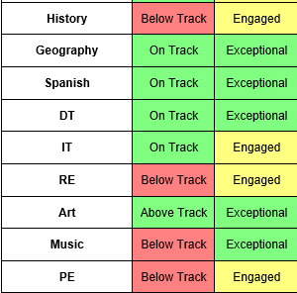
Useful Information
When picking the subjects, students should be considering the subjects where they make good progress and engaged in their learning.
He would probably pick Geography and Spanish as he is doing well in these two subjects.
The student is making progress in Art so this would be a good choice.
He can still pick another subject, for example DT.

Slide 11
Subject Information
The information about every course is on the school website.
This includes links to the course websites and all the assessments.
Careers information is also included.

Slide 12
Guided Pathways – Subject selection.
Read the Subject information document.
Use the aspirations advice and recent progress data report to decide which courses are the most suitable.
You should pick one subject from Block A (plus a reserve) and three from Block B (two reserves).
Use all the information you have to discuss your preferences at home.
Select subjects using www.sims-options.co.uk (deadline Friday 19 April). Details next slide.
Subjects are confirmed at a later date.
If you need extra advice please send an email to guidedpathways@audenshawschool.org.uk and a member of the leadership team will be in touch.

Slide 13
Online subject pre-selection system - SIMS
Parents and carers will receive an email from noreply.sims.co.uk.
Click on the ‘accept invitation’ button and choose the sign-in method to use.
This will open the system for pre-selection.
The subject choices are submitted using www.sims-options.co.uk
You should pick one subject from Block A (plus a reserve) and three from Block B (two reserves).
If you need extra advice please email guidedpathways@audenshawschool.org.uk and a member of the leadership team will be in touch.

Slide 14
Online subject pre-selection system - SIMS
The subject choices are submitted using www.sims-options.co.uk
They log on using their School email address. 21surnameinitial@audenshawschool.org.uk. Use the password they use to login to school computers.
This will open the system for pre-selection.
You should pick one subject from Block A (plus a reserve) and three from Block B (two reserves).
If you need extra advice please email guidedpathways@audenshawschool.org.uk and a member of the leadership team will be in touch.

Slide 15
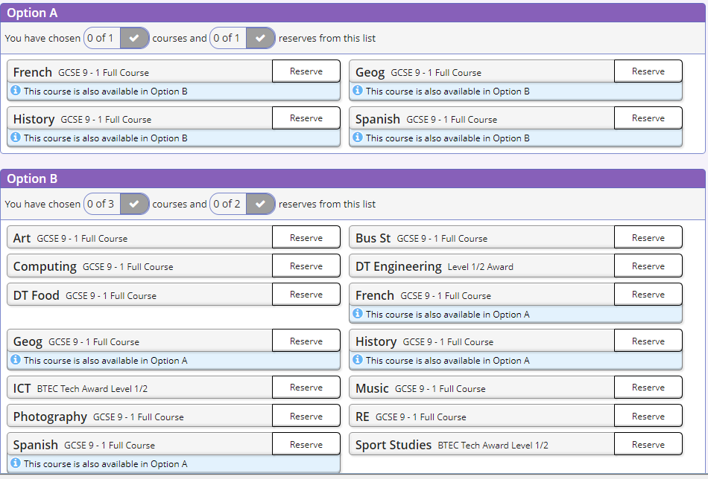

Slide 16
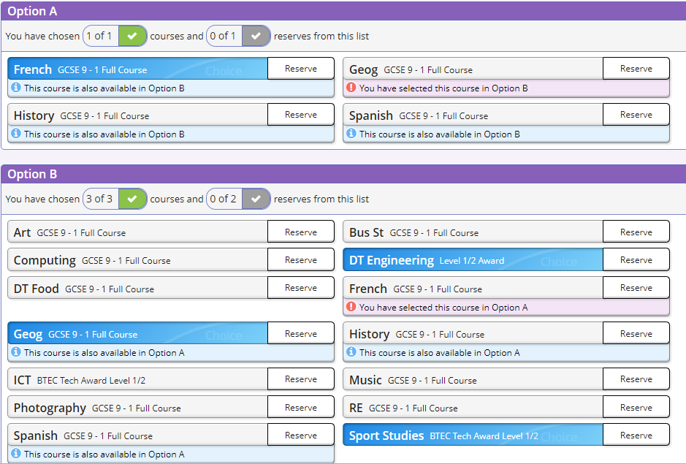

Slide 17
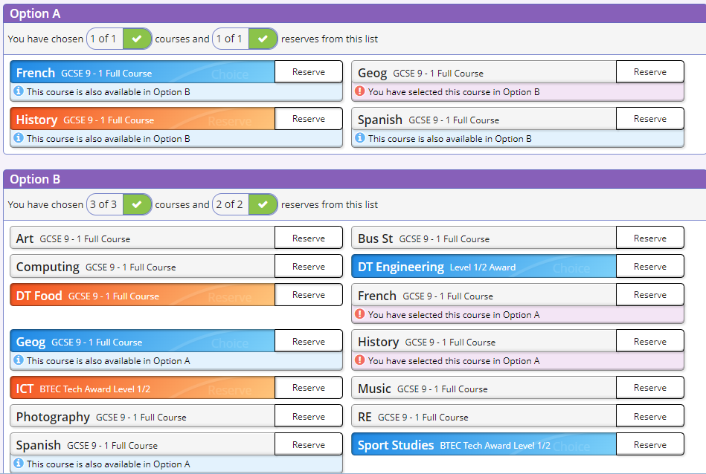

Slide 18
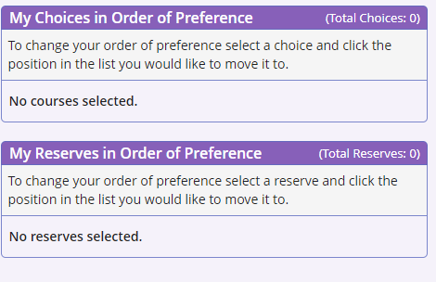

Slide 19
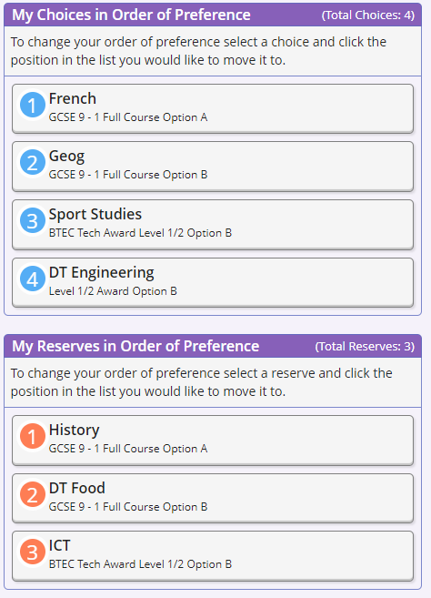

Slide 20
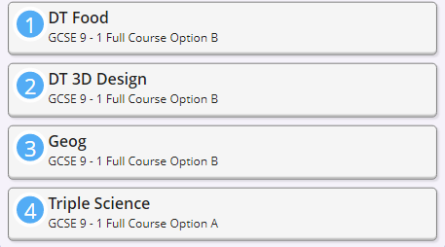
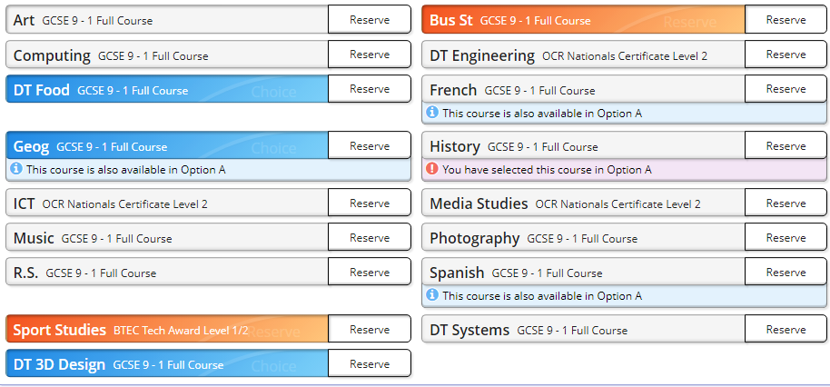
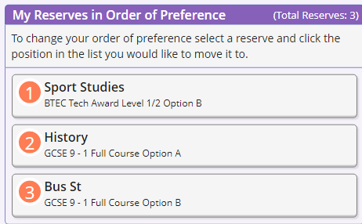
Example of completed sheet.
Selected subjects in order

Slide 21
For popular subjects like Photography, Sport and Triple Science, students need to have these as one of their highest ranked preferences.

Slide 22
Common Questions
Will I get my first choice subjects?
Most students get their first choices although some unusual combinations might not fit. You will be contacted if there are any problems.
Can I change my mind?
Think very carefully about your choices now as it becomes more difficult to make changes later.
Are there any subjects that you can’t do together?
Students are not able to do Art and 3D Design.
Do I still study RS if I don’t pick it?
All students will study the short-course RS qualification.
Do I still do PE if I don’t choose BTEC Sport?
All students will still have Games lessons each week.

Slide 23
Audenshaw School
Guided Pathways
If you need extra advice please email guidedpathways@audenshawschool.org.uk and a member of the leadership team will be in touch.

